Slide 1
Docker Architecture
25-Sep-23
AVIN Systems Private Limited
AVIN Systems Private Limited - Confidential

Slide 2
Contents
Docker Architecture
Components of Docker Architecture
Docker Engine
Docker Image
Docker Container
Dockerfile
Docker Registry
Docker Compose
Docker Network
Docker Security
Conclusion

Slide 3
Docker Architecture
Docker uses a client-server architecture.
The Docker client talks to the Docker daemon, which does the heavy lifting of building, running, and distributing your Docker containers.
The Docker client and daemon can run on the same system, or you can connect a Docker client to a remote Docker daemon.
The Docker client and daemon communicate using a REST API, over UNIX sockets or a network interface. Another Docker client is Docker Compose, that lets you work with applications consisting of a set of containers.

Slide 4
Components of Docker Architecture
Docker Engine
Docker Deamon
REST API
Docker Client (Command Line Interface)
Dockerfile
Docker Image
Docker Container
Docker Registery
Docker Compose
Docker Network
Docker Security

Slide 5
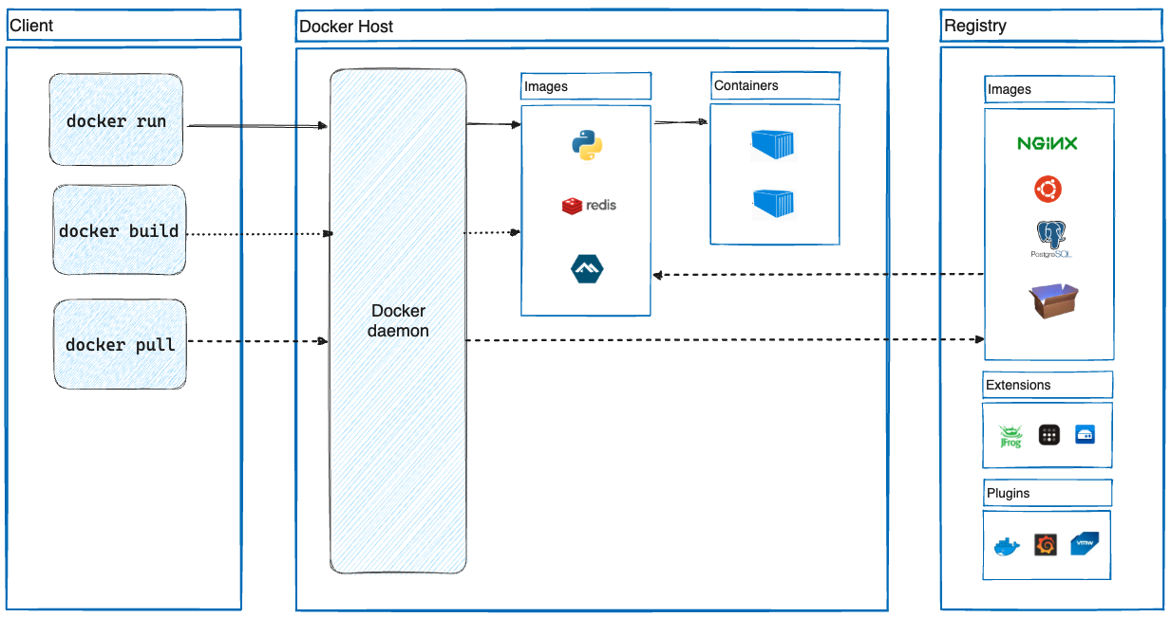
Docker Architecture

Slide 6
Docker Engine
Docker Engine is the core software component of the Docker platform, that hosts and manages containers.
It comprises of the Docker Daemon, REST API, and Docker Client, working together to create, run and manage containers and also to provide a user-friendly interface for containerization and container management.

Slide 7
Docker Deamon
The Docker Daemon, often referred to simply as the "Docker daemon" or "Docker server," is a long-running background service that runs on a host system. It is responsible for:
Creating and managing Docker containers.
Storing and managing Docker images.
Configuring and managing Docker networks and volumes.
Handling container lifecycle operations, including starting, stopping, and removing containers.

Slide 8
Docker REST API
REST APIs provide a standardized way to interact with and manage Docker containers, making it easier to automate, orchestrate, and integrate containerized applications into your overall software ecosystem.
REST APIs can be used to interact with the Docker Daemon, the core component of Docker Engine, to perform operations such as creating, starting, stopping, and removing containers.
The REST API is a crucial part of Docker's architecture because it enables programmatic control and automation of Docker containers and resources.

Slide 9
Docker Client
The Docker Client, also known as the Docker CLI (Command-Line Interface), is a command-line tool that allows users to interact with the Docker Daemon.
Users issue Docker commands through the CLI to manage containers, images, networks, volumes, and other Docker-related operations.
The Docker Client communicates with the Docker Daemon via the REST API.

Slide 10
Dockerfiles
A Dockerfile is a text file that contains a set of instructions for building a Docker image.
Docker images serve as the blueprints for creating containers, and a Dockerfile provides a clear and repeatable way to define the components and configuration of an image.
Once you've created a Dockerfile, you can use the `docker build` command to build an image from it.
The resulting image can then be used to create and run containers.
Dockerfiles provide a way to automate the image creation process, ensuring consistency and repeatability in application deployment across different environments.

Slide 11
Docker Image
Docker images are lightweight, standalone, and executable packages that include the application's code, runtime, system tools, libraries, and settings.
Images are used to create containers, and they are built using a Dockerfile, which specifies the instructions for creating the image.
Images are typically layered, allowing for efficient sharing of common layers between images.
Some Features of Docker Image are:
Layered
Immutable
Stored In Registry
Portability

Slide 12
Docker Container
A Docker container is a runnable instance of a Docker image. It is a lightweight and isolated environment that encapsulates an application and its dependencies.
Containers are created from Docker images and run as separate processes on the host system.
Some Features of Docker Container are:
Runnable
Mutable
Portability
Lifecycle

Slide 13
Docker Registery
A Docker registry is a central repository for storing, managing, and distributing Docker images.
Docker images serve as the blueprints for creating containers, and a registry is where these images are hosted and made available to users and systems.
Docker registries play a critical role in the Docker ecosystem by facilitating the sharing, distribution, and version control of Docker images.
They are essential for collaborative development, application deployment, and container orchestration in both public and private cloud environments.

Slide 14
Docker Compose
Docker Compose is a tool for defining and running multi-container applications.
It uses a simple, declarative YAML (Yet Another Markup Language) file to define the services, networks, and volumes that make up an application stack.
Docker Compose allows you to start and manage multiple containers as a single application, making it easier to develop, test, and deploy complex applications that consist of multiple interconnected components.
Docker Compose simplifies the management of multi-container applications, allowing developers to define their application's architecture and dependencies in a single file.
It streamlines the process of setting up complex development environments, enabling faster and more reliable development and testing of containerized applications.

Slide 15
Docker Network
Docker provides networking capabilities that allow containers to communicate with each other and the outside world.
Docker networks are used to create isolated communication channels for containers, making it possible for them to interact securely and efficiently, and because of this, it is easier to deploy and manage distributed systems and microservices architectures using Docker.
Docker networking is a powerful feature that allows you to create complex network topologies for your containerized applications.

Slide 16
Docker Security
Docker security is a critical aspect of containerization because containers share the same kernel as the host operating system, making it essential to implement robust security practices to protect both the host system and the containers themselves.
Docker security ensures that your applications and data remain safe and protected when using Docker containers.
Docker security is an ongoing process, and it's essential to stay up to date with the latest security practices and tools to protect your containerized environments effectively.
Regularly assess and update your security measures as new threats and vulnerabilities emerge.

Slide 17
Thank You

